Slide 1

GYM MANAGEMENT SYSTEM

Slide 2
BASIC IDEA AND OVERVIEW
To provide an interface to keep track of daily exercises by trainee
To help the trainer to create sessions for all the trainess
To update databases accordingly

Slide 3
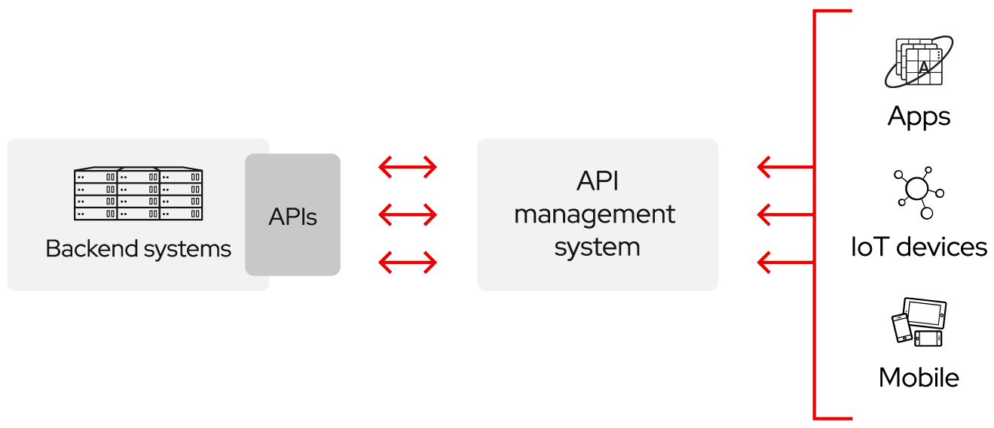
API
API stands for application programming interface, which is a set of definitions and protocols for building and integrating application software.

Slide 4

HOW DO APIs WORK?
APIs let your product or service communicate with other products and services without having to know how they’re implemented. This can simplify app development, saving time and money. When you’re designing new tools and products—or managing existing ones—APIs give you flexibility; simplify design, administration, and use; and provide opportunities for innovation.
APIs are sometimes thought of as contracts, with documentation that represents an agreement between parties: If party 1 sends a remote request structured a particular way, this is how party 2’s software will respond.

Slide 5
CLOUD DATABASES AND ATLAS
Cloud databases are databases that are hosted on cloud computing platforms, allowing users to access and manage data over the internet. With cloud databases, users do not need to manage physical hardware or install software on their own systems, as the databases are hosted and managed by the cloud provider.
There are several types of cloud databases, including:
Relational Databases: These databases are based on the relational model and use SQL (Structured Query Language) to manage data.
NoSQL Databases: These databases do not use the traditional table-based relational model and are designed to handle large volumes of unstructured data.
Graph Databases: These databases are designed to manage highly interconnected data, such as social networks or supply chains.
Object-Oriented Databases: These databases are designed to store and manage object-oriented programming language data structures, such as Java or Python.

Slide 6
ATLAS FOR MONGODB
Atlas MongoDB is a cloud-based database service that offers a fully managed MongoDB database. MongoDB is a popular NoSQL database that allows for the storage and retrieval of unstructured or semi-structured data in a flexible and scalable manner.
Atlas MongoDB provides a wide range of features and benefits, including:
Fully managed service: Atlas MongoDB is fully managed by MongoDB, Inc. This means that the provider takes care of the infrastructure, security, and maintenance of the database, allowing users to focus on their applications and data.
Scalability: Atlas MongoDB can easily scale up or down to handle changing workloads or data volume. This makes it ideal for applications that experience unpredictable traffic or growth.
High availability: Atlas MongoDB provides high availability and fault tolerance by replicating data across multiple nodes in different availability zones.
Automated backups and disaster recovery: Atlas MongoDB offers automated backups and disaster recovery, ensuring that users can quickly and easily recover from any data loss or outage.

Slide 7
FRONTEND OF OUR PROJECT
TOOLS USED:
HTML
CSS
BASIC OUTLINE:
Our project contains several internally running HTML documents that are specific to the type of user – Trainee or Trainer. It also various login and signup options .

Slide 8
SAMPLE CODE FOR LOGIN
<html>
<head>
<link rel="stylesheet" href="sty.css">
</head>
<body>
<table class="center">
<tr>
<td><input type="Button" value="Trainer" onclick="window.location.href='Int6.html'" ></td>
</tr>
<tr>
<td><input type="Button" value="Trainee" onclick="window.location.href='Int2.html'"></td>
</tr>
</table>
</body>
</html>

Slide 9
BACKEND OF OUR PROJECT
TOOLS USED:
FLASK
PYMONGO
BASIC OUTLINE:
Our project contains a single python file which controls and manages all kind of database accesses using PYMONGO and all kind of updates using flask.

Slide 10
SAMPLE PYTHON CODE
Code:
@app.route('/signup',methods=['POST'])
def fun1():
name=request.form['Name']
age=request.form['Age']
gender=request.form['G']
address=request.form['Add']
height=request.form['hei']
weight=request.form['wei']
level=request.form.get('sel')
pass1=request.form['pass']
v1={"Username":name,"Password":pass1}
v={"Name":name,"Age":age,"Gender":gender,"Address":address,"Height":height,"Weight":weight,"Level":level,"Password":pass1}
col1.insert_one(v)
col.insert_one(v1)
return render_template("Int.html")
if __name__ == "__main__":
app.run(host='localhost', port=5000, debug=True)

Slide 11
DEMONSTRATION

